Slide 1



EQ 2022
Elite Sapiens (Jadavpur University)
Arnab Dutta
Md Minhaz Rahaman

Slide 2
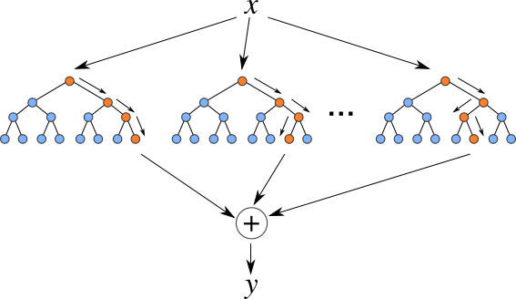
Understanding the problem
Basic Understanding
In 2018, ABC’s new product ‘Term Deposit’ was a success and it’s subscription benefited the firm.
So, this year ABC is running a campaign to identify 1000 customers from their database, whom, contacting via telecommunication channels will provide efficient results/ maximum subscription owing to its time and budget constraints.
Random Forest pictorial representation
Approach Framework
The problem requires in depth analysis of previous campaign’s customer data, and compare it with background data of the current customers to find optimal 1000 customers to be contacted.
So, the model to predict the optimal customers to be contacted is based on Random Forest which is a supervised learning algorithm that is based on the ensemble learning method .

Slide 3
Data Processing and Treatment
→ Excel
The data provided consisted of few blank cells. To deal with that, first we removed the rows which had missing values among the non-numeric columns.
For missing values of numeric columns, we substituted the blanks with median of the corresponding column, so that the values of the other factors which contribute to the predicting model do not get ignored.
The columns with binary values(i.e Yes/No) were converted to 1’s and 0’s (i.e. 1 → Yes & 0 → No)
→ Python
For columns consisting of categorical non-binary data having nominal values (e.g- “marital status” variable with the values: “single”, “married” and “divorced”) which do not have natural ordering, One Hot Encoding technique is implemented, which replaces the data with dummy variables.
After One Hot Encoding is done, and ‘n’ columns are obtained, we drop one of the columns, because ‘n-1’ columns provide sufficient information to determine that particular characteristic.

Slide 4
Methodology and Solution Design
Model Selection
Model Training
Predicting Subscription
Finding the Optimal 1000
Reasons for model selection
High accuracy
The algorithm scales well when new features or samples are added to the dataset
Random Forest is generally used if:
It is not a time series problem
The data has a non-linear trend and extrapolation is not crucial
After processing the data, model is trained using Random forest algorithm, using historical data of previous campaign.
It is applied because there is no linearity in the data set and the given problem is a binary classification problem.
The new customer background data is fed into the trained model.
The predicted probabilistic subscription values for the targeted set of customers are obtained.
The customer id and predicted values are exported to an excel file.
The data is sorted in decreasing order of the predicted value.
The top 1000 are the required customers.
Important parameters of model
R2 Score→0.8844552588169639
Mean Absolute Error→0.0572430262
Mean Square Error→0.01097271766
Root Mean Square Error→0.1047507
**The complete code for solution design is attached here in pdf format:

Slide 5

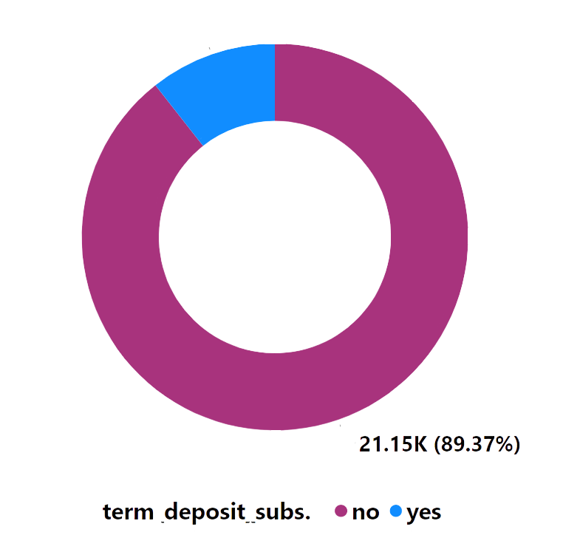
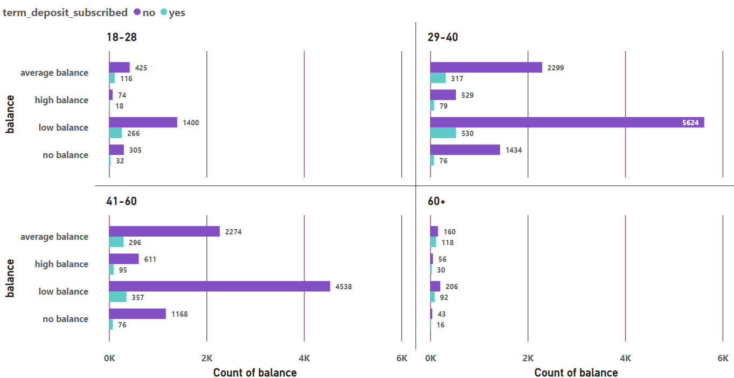
Data Visualisation
Factors | Max | Min | Mean | Std. Dev.
Customer_age | 93 | 18 | 40.34928149 | 10.64364931
Balance | 98419 | -8020 | 1353.686729 | 3008.249068
last_contact_duration | 1019 | 661 | 854.8549451 | 74.56699587
num_contact_in_campaign | 63 | 1 | 2.771470837 | 3.12309517
num_contact_in_prev_campaign | 275 | 0 | 0.5844885883 | 2.633077199
no balance-(<0), low balance (1-1000), avg balance (1001-5000). high balance (>5000)
Most number of the customers lie in the low balance category.
Most number of customers lie in the age group of 29-40 while, least number of customers lie in 60+ age.
Through the bar graph, conclusions can be drawn that 60+ age group in the average balance category has best conversion rate of taking term deposit in all balance categories and 29-40 age group in average balance category has the least.
**The complete data visualisation charts are attached here:

Slide 6
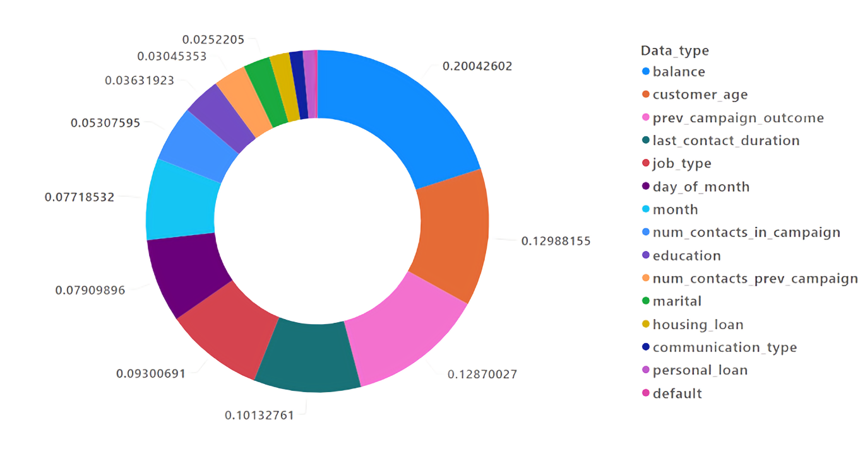
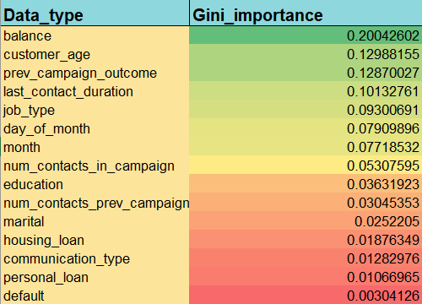
Factors that contributed the most in Subscription
The importance of a feature is computed as the (normalized) total reduction of the criterion brought by that feature. It is also known as the Gini importance.

